Slide 1
Project
Private Banking
Proposal
Group 2
Presented by Yong Guo, Songtao Sun, Sameeksha Sen Thakuri, Lin Chen
Instructor: Professor Promila Bahadur

Slide 2
Project Aims
The aim of our project is to practise the OOA and OOD, and implement the coding in JAVA.
This project covers purpose of private banking requirement system analysis, system design, system implementation and system testing.

Slide 3
Project Features
Client-Server Model based on sockets and ports.
Multithreaded Server having Microsoft Database.
Client Side is platform Independent

Slide 4
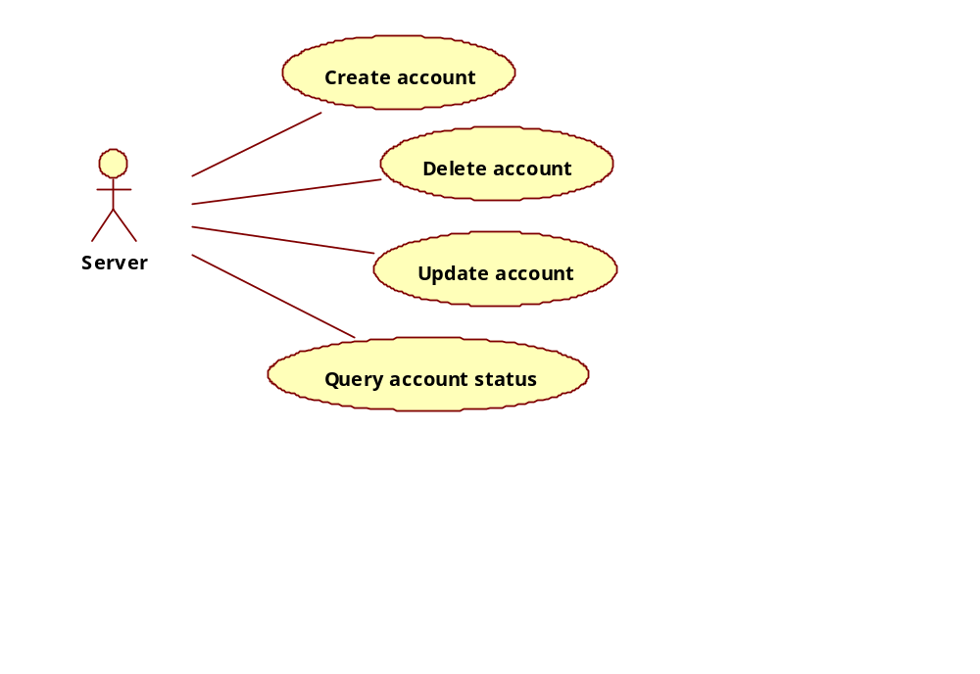
Project Requirements

Slide 5
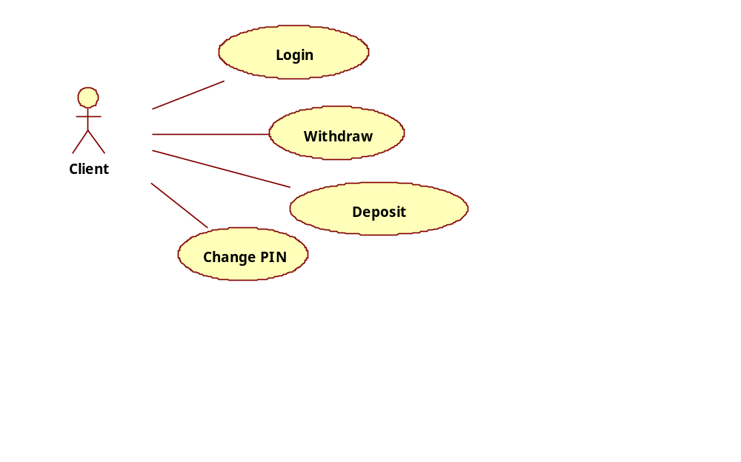
Project Requirements

Slide 6


